Slide 1
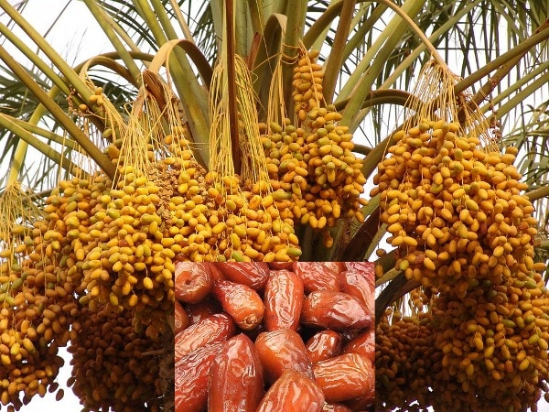
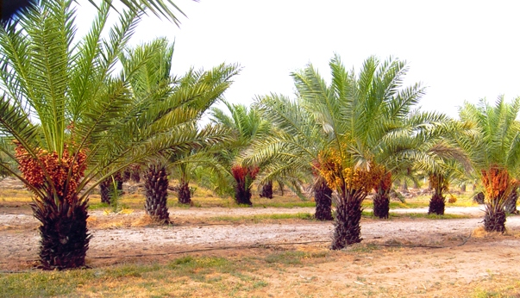

Yearly 20 Lakhs Income from 1Ac by Date Palm Cultivation
9-52; Harmony Homes; Lalgadimalakpet; Shamirpet; Hyderabad-500078
AP: Survey No: 1237/2; Devapatla(Vil) Sambepalli(M);Kadapa Dt-516215
www.vikasbiosciences.com www.kalleagriclinics.com
Contact No: +91 789 300 9995 / +91 889 724 5050
Email: srkalle@gmail.com / kalle@kalleagriclinics.com /
srini@vikasbiosciences.com

Slide 2

Introduction
We are as a Kalle Agri-clinics (www.kalleagriclinics.com) Dealing with Organic & Biodynamic Agriculture consultancy services since 1997. Promoted a Seeds Company of Vikas Biosciences Pvt Ltd (www.vikasbiosciences.com) in 2016 and deal with Maize & Cotton seeds and Organic Bio Products to the farmers in all Indian states.
We are promoting the Dates Crop, in this way we give 100% solutions right from the beginning with Tissue Culture Plants, Planting methods, Soil Enrichment, Plant Nutrients, Pest & Diseases Management and Fruit Buy Back arrangements.
Every one can search in about success stories by typing “Dates Cultivation in India” or “Dates Cultivation in AP TS”

Slide 3
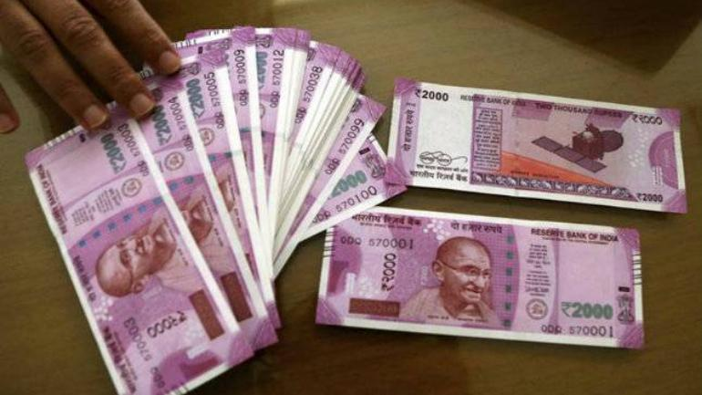
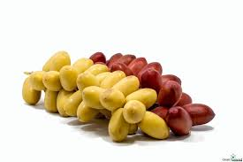
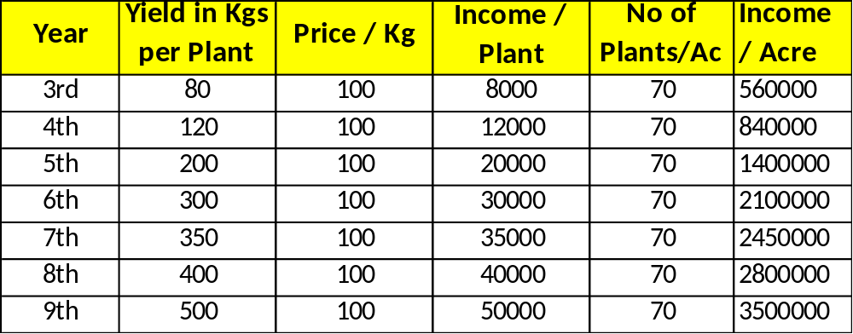
Income from 1 Acre:
Income will Start from 3rd Year onwards once you do planting and 80 Years Life span of Dates Tree.
6th year onwards Income will be 20 Lakhs+ (depends on crop management & Natural Environment). We give all Cultivation Practices.
After 9th year onwards up to 80 years yield will be standard.

Slide 4
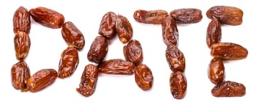
Why to do Dates Cultivation?
India is Importing 5 lakh Tons Date Fruits yearly from Gulf countries
As per Demand & Supply, Supply is very less and increasing the Dates consumption day by day.
So cultivating in Lakh Hectares also meet up the Demand is huge gap
Date fruit has more Medicinal properties with Low Glycaemic Index, so Diabetics also can consume it. Doctors are recommending to use Dates Syrups instead of Sugar adding in the milk to children for better health. Even can use in Coffee & Tea (Due to original Honey availability)

Slide 5
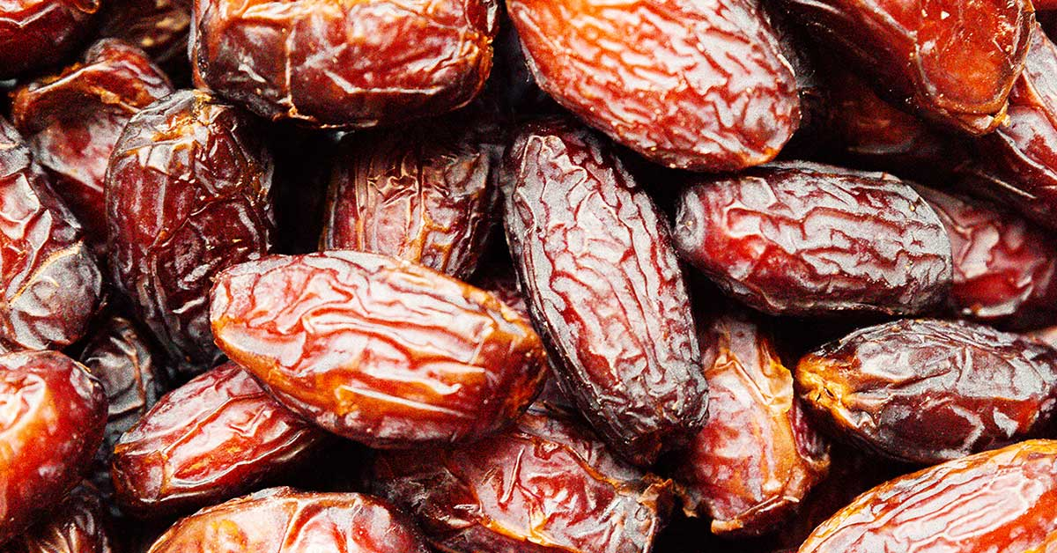
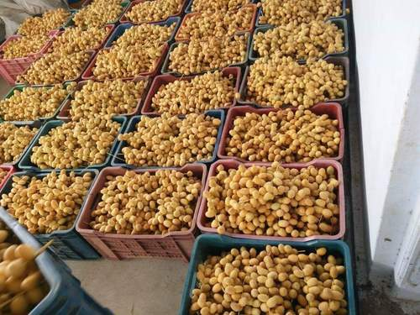
Why to do Dates Cultivation?
Health Benefits of Date Fruits
Promotes Heart health & reduces Heart Diseases
Helps in preventing Colon Cancer
Prevents Iron deficiency and Anaemia
Helps to boosting Sexual Health
Relieves Constipation & Regulates Bowl movements
Controls Diarrhea
Reduces Blood Pressure
Promotes Respiratory & Digestive health
Helps in Pregnancy & Deliveries
Helps in Arthritis Patients
Helps in reducing Colitis risk
Helps in weight gain

Slide 6
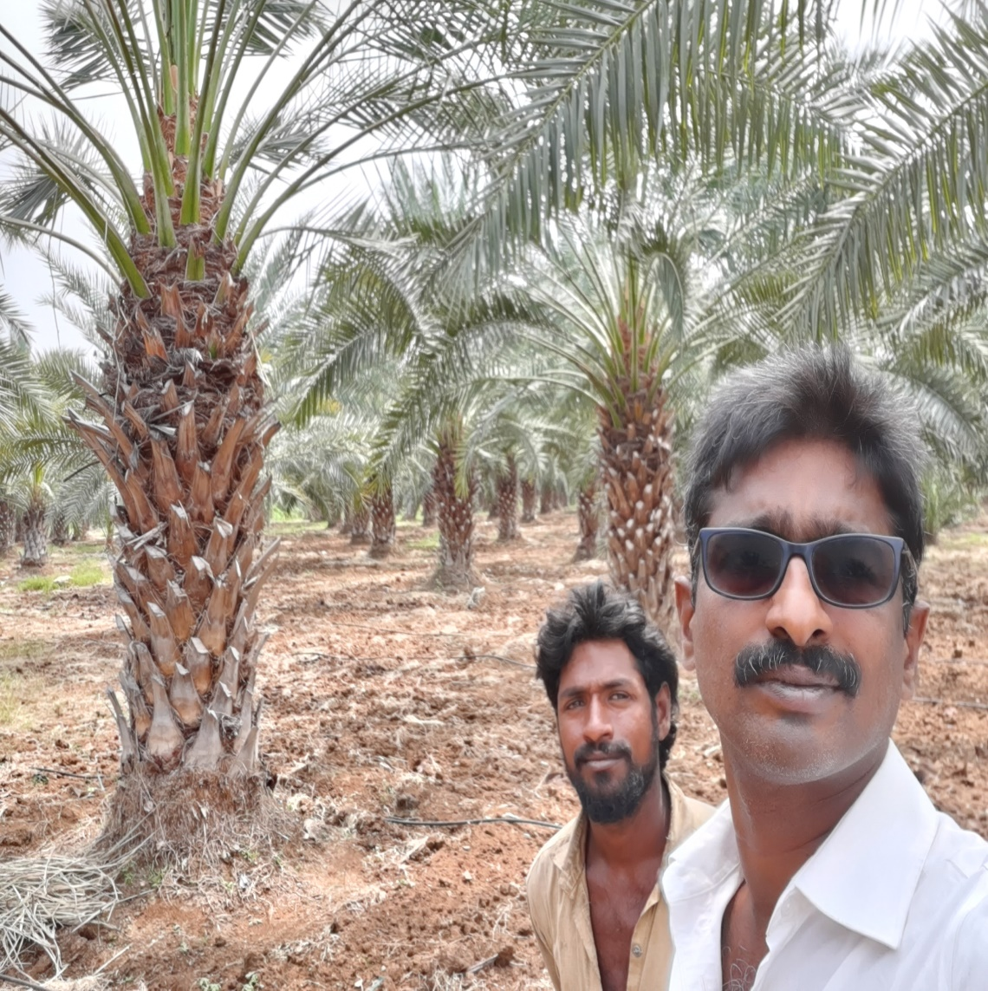
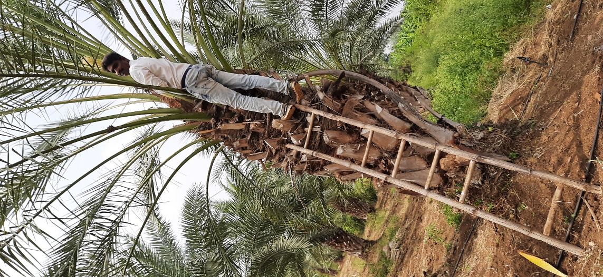
7Years Trees (above to start flowering)as on Feb 2021

Slide 7
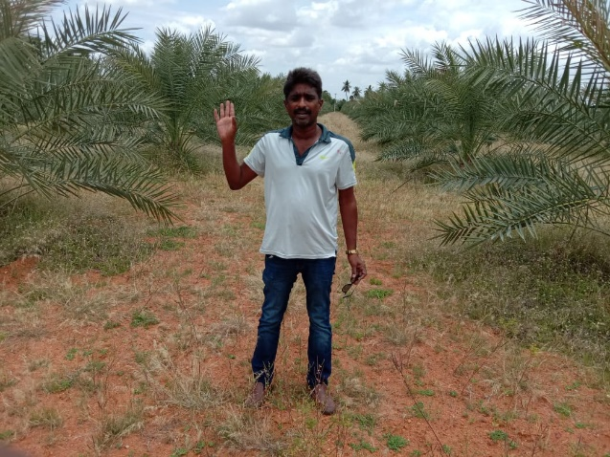
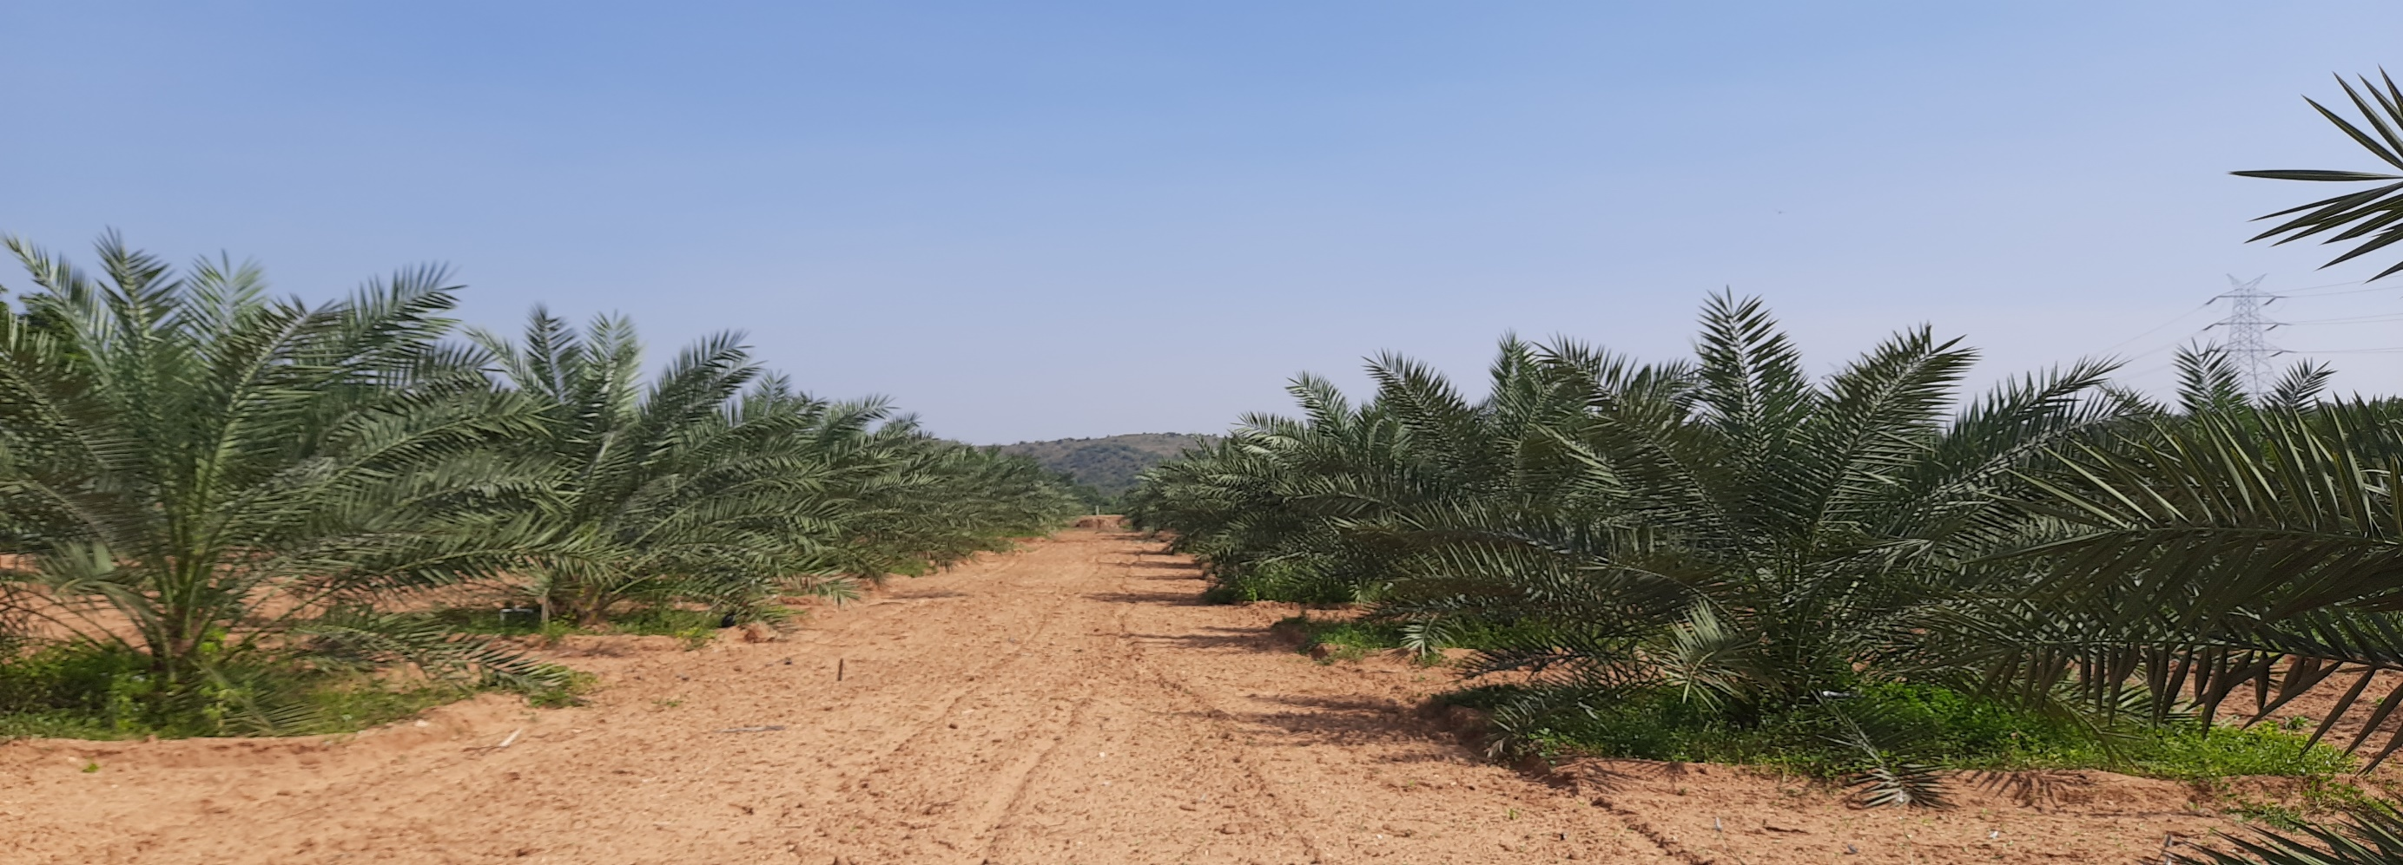

Dates Plantation

Slide 8
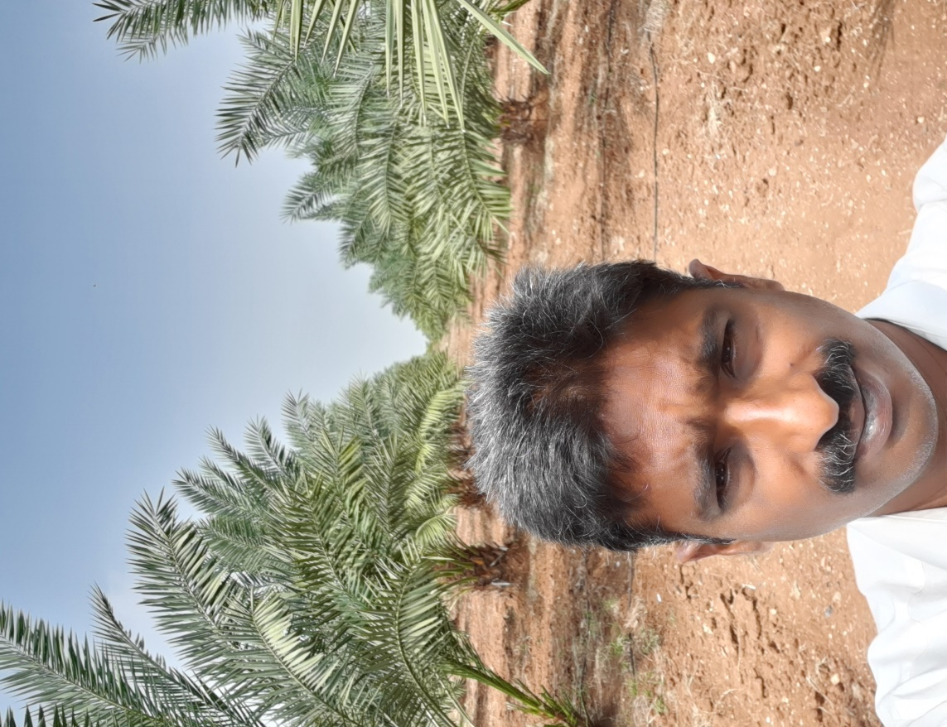
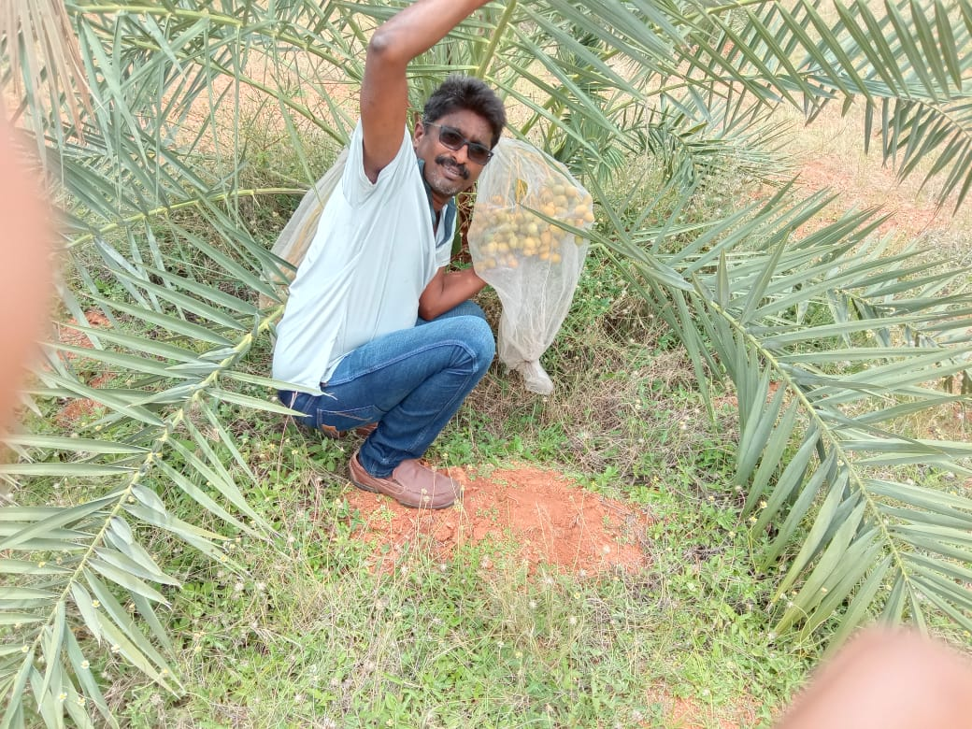
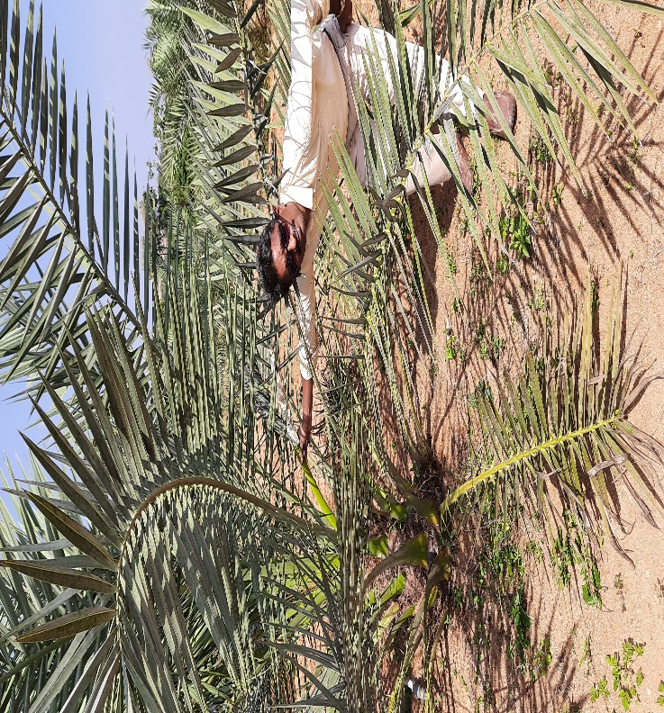
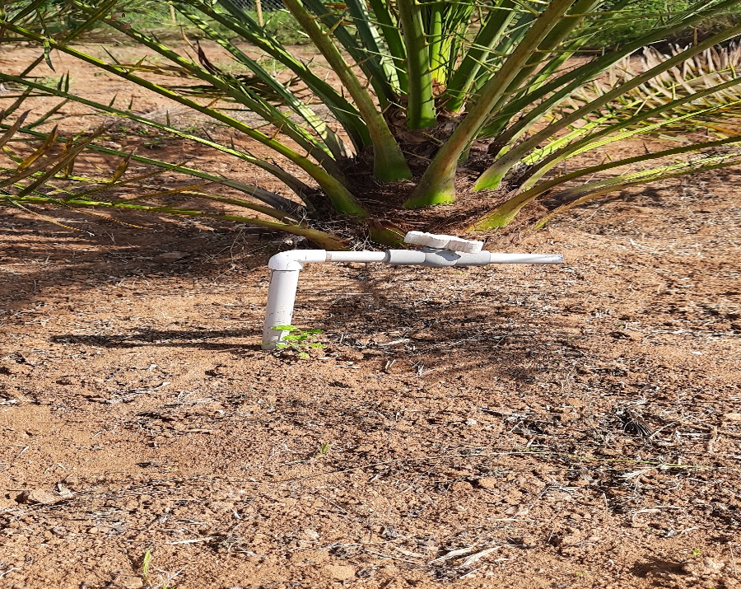
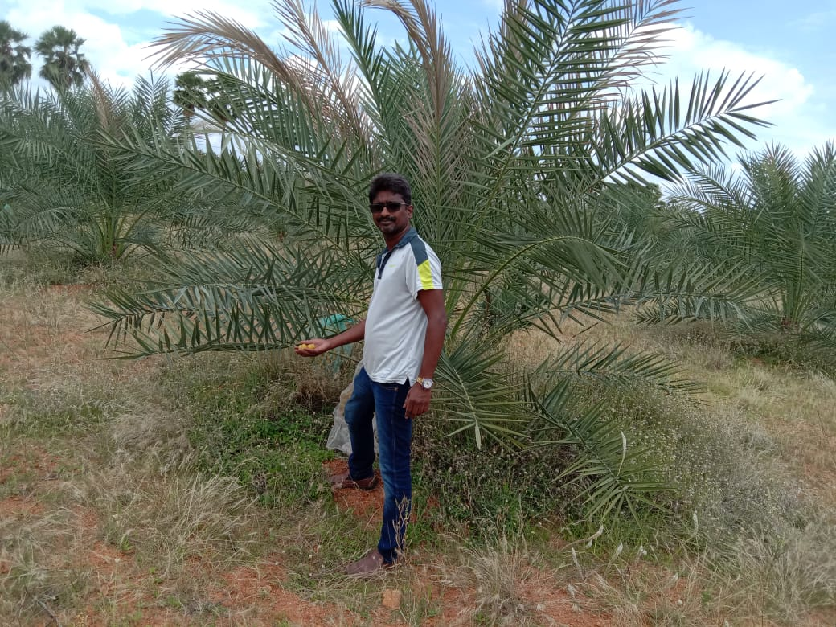
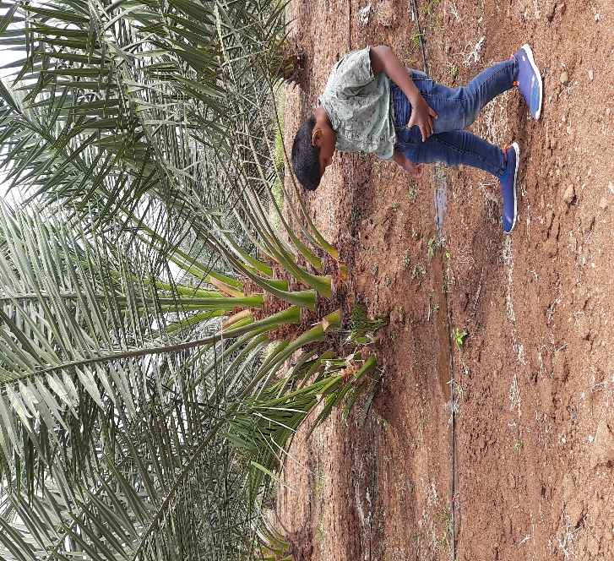
Our Plantation (at the age of 2 Years July2020)

Slide 9
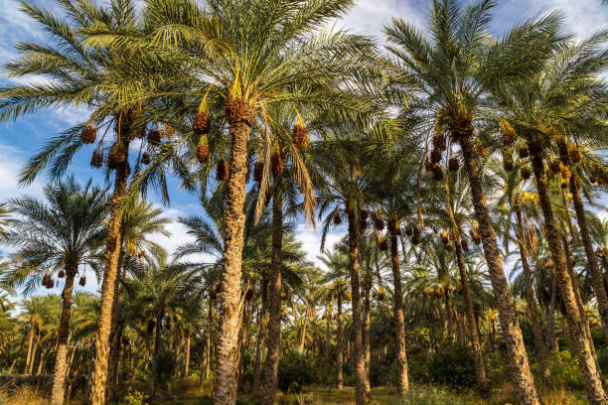
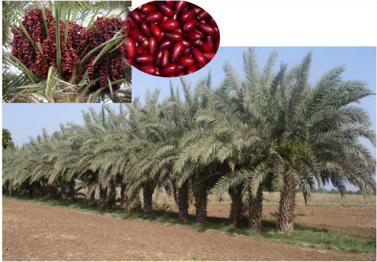
No of Plants Per 1 Acre
Option 1: 23X23 Feet distance, 80 plants per Acre (72 Female, 8 Male)
Option2: 21X21 Feet distance, 100 plants per Acre (90 Female,10 Male)
OR
Can plant 10 Female & 1 Male or
20 Female & 2 Male or
30 Female & 3 Male or
40 Female & 4 Male and so on…

Slide 10
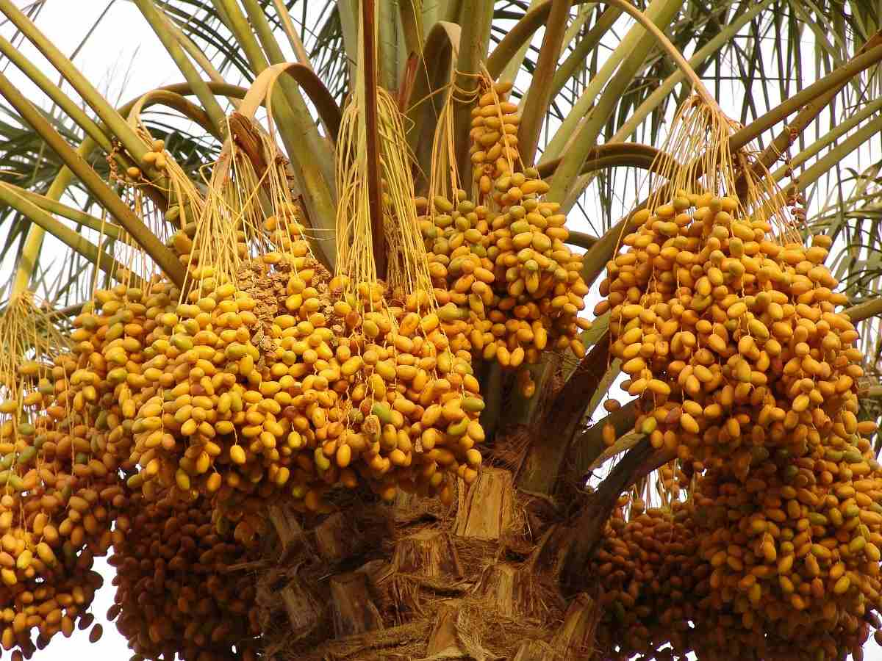
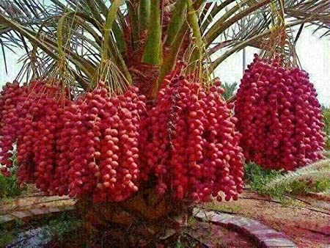
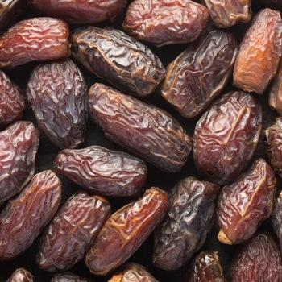
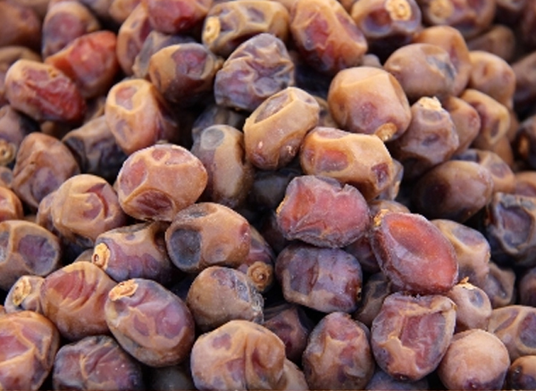
Varieties:
1.Barhi 2.Medjool

Slide 11
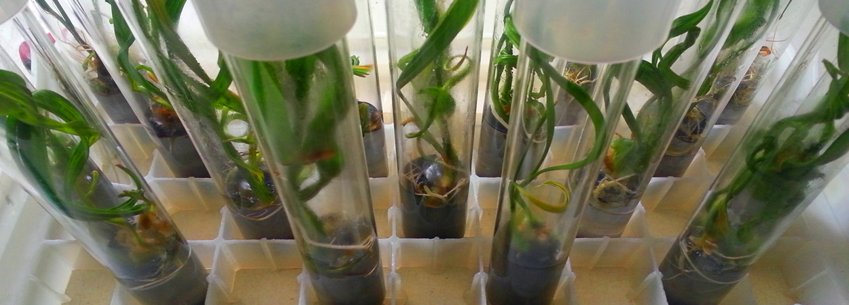
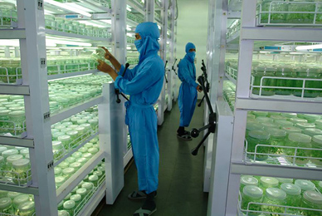
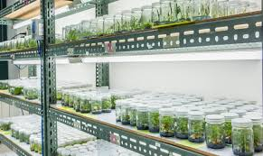
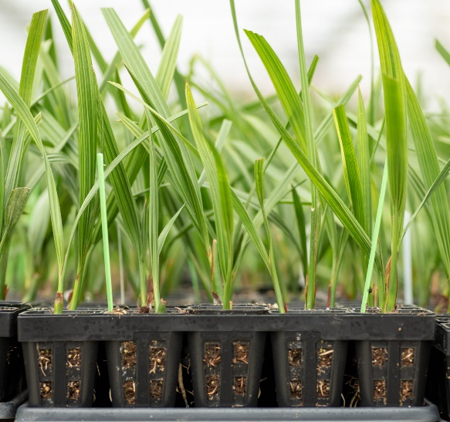
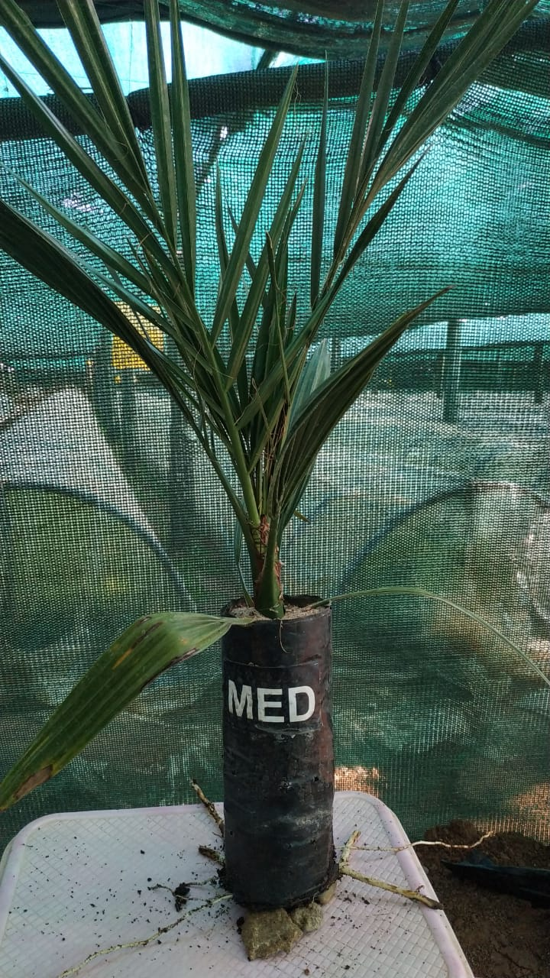
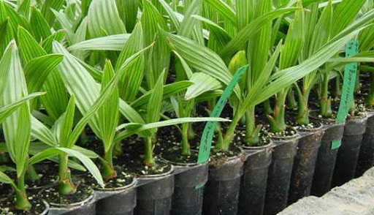
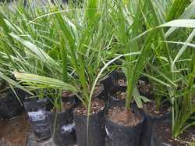
Tissue Culture Plants.
Both Female & Male Plant Price: Rs4,500/- X80=3,60,000 per 1Acre.

Slide 12

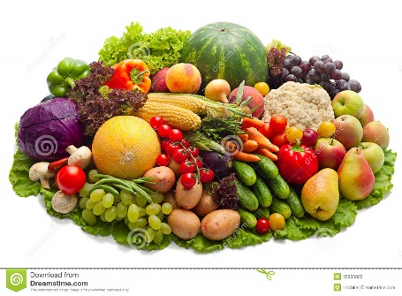
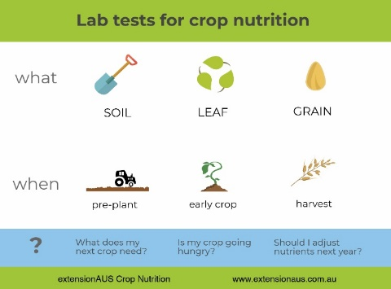
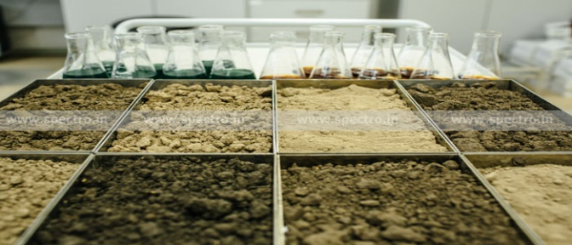
Agri Consultancy Services
We provide all Agriculture (Organic and Conventional) Technical Services to require people for Dates and all the Crops at Chargeable.
Soil Testing
Leaf Testing for existing Fruit Plants
Soil Enrichment & Soil Health Management
Plant Nutrients
Pests & Diseases Management
High Yield Management
Pre Harvest & Post Harvest Techniques
Marketing (Buy Back) arrangements

Slide 13
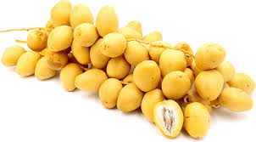
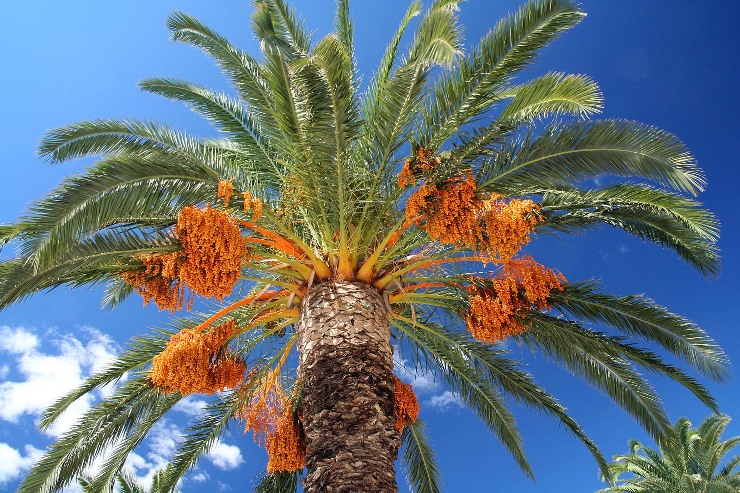
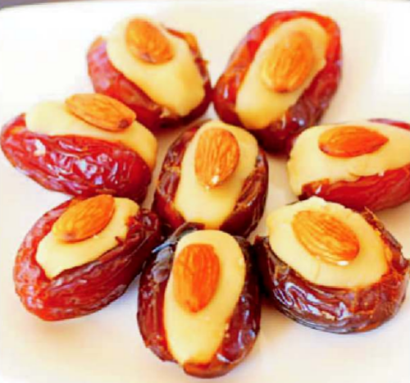
Thanks with Valuable Dates

